Slide 1
The Man Who Loved His Little Girl
Presented by The Crazy Saturdays
Timothy Rivers, Charlie Lee, Maria Ng, Sabrinia Crouch Client: Potential Movie Producer-William Moneybags 18 Dec 2019

Slide 2



INTRODUCTION
Here we will show you that not only is our movie going to be profitable, but we have performed an extensive analysis to show that we have optimized the language, genre, release date, popularity and runtime to yield the highest revenue
We have also performed an analysis of previous titles across genres to optimize titling of the movie
Following this presentation, we hope that you agree to provide us the money needed to fund our sure-fire venture

Slide 3
PREPARING THE DATASET
The Movies DataSet was used to perform our analysis
These files contain metadata for all 45,000 movies listed in the Full MovieLens Dataset. The dataset consists of movies released on or before July 2017.
Data points include cast, crew, plot keywords, budget, revenue, posters, release dates, languages, production companies, countries, TMDB vote counts and vote averages.
This dataset also has files containing 26 million ratings from 270,000 users for all 45,000 movies. Ratings are on a scale of 1-5 and have been obtained from the official GroupLens website.
Notes:
https://www.kaggle.com/rounakbanik/the-movies-dataset#movies_metadata.csv

Slide 4
Selecting the Genre
We built a linear model to identify which genres had a significant correlation with revenue
We identified that music and animation are the most significant
However neither model had a good R^2 (Both ~0.02)
lm(formula = revenue ~ Action + Adventure + Animation + Comedy + Crime + Documentary + Drama + Family + Fantasy + Foreign + History + Horror + Music + Mystery + Romance + Science.Fiction +
Thriller + TV + Western, data = genre)
Notes:
Animation
lm(formula = ROI ~ Animation, data = genre)
Residuals:
Min 1Q Median 3Q Max
-304425888 -55541142 -40315580 2406107 1343345264
Coefficients:
Estimate Std. Error t value Pr(>|t|)
(Intercept) 45058430 3620725 12.445 <2e-16 ***
Animation[T.Animation] 138944662 22604171 6.147 1e-09 ***
---
Signif. codes: 0 '***' 0.001 '**' 0.01 '*' 0.05 '.' 0.1 ' ' 1
Residual standard error: 141100000 on 1557 degrees of freedom
(43904 observations deleted due to missingness)
Multiple R-squared: 0.02369, Adjusted R-squared: 0.02307
F-statistic: 37.78 on 1 and 1557 DF, p-value: 0.000000001002
Music
lm(formula = ROI ~ Music, data = genre)
Residuals:
Min 1Q Median 3Q Max
-302756232 -56173851 -39688774 2058937 1345014920
Coefficients:
Estimate Std. Error t value Pr(>|t|)
(Intercept) 59189578 17145715 3.452 0.000571 ***
Music[T.0] -15800804 17552295 -0.900 0.368146
Music[T.Music] 79960353 23751111 3.367 0.000780 ***
---
Signif. codes: 0 '***' 0.001 '**' 0.01 '*' 0.05 '.' 0.1 ' ' 1
Residual standard error: 141400000 on 1556 degrees of freedom
(43904 observations deleted due to missingness)
Multiple R-squared: 0.02056, Adjusted R-squared: 0.0193
F-statistic: 16.33 on 2 and 1556 DF, p-value: 0.0000000958

Slide 5
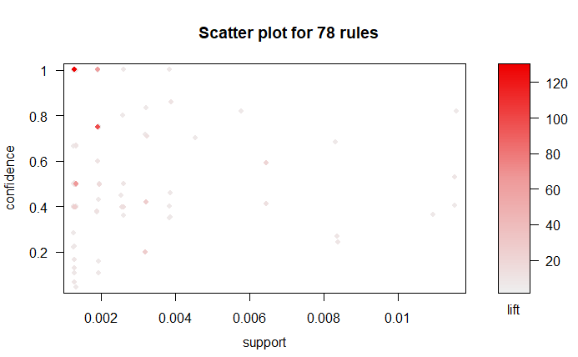
Text mining relationships
We also wanted to know if animation and music occurred frequently together
In none of the top 78 rules for our data set where lift >5, animation and music do not appear together
goodrules_md_TDM1<-arules_md_TDM1[quality(rules_md_TDM1)$lift > 5]
Notes:
#install.packages("readxl")
library(readxl)
#import the downloaded excel
md_TDM <- read.csv("C:/Users/scrouch/Desktop/Syracuse University/IST 687/Project/movie_data__genre_ROI_na rm_TDM.csv")
#TDM<-(termDocMatrix)
md_TDM<-data.frame(md_TDM)#create a new dataframe (TDM) of the imported dataset "termDocMatrix"
summary(md_TDM) # view the summary of TDM
#TDM1<-t(TDM) #transpose TDM into a new dataset TDM1
#View(md_TDM) # view the new dataframe TDM1
summary(md_TDM) # summary of TDM1
#install.packages("arules")
#install.packages("arulesViz")
library(arules)
library(arulesViz)
md_TDM<-as.matrix(md_TDM)
class(md_TDM) #confirm that TDM1 is a matrix
md_TDM1 <- as(md_TDM, "transactions") #convert TDM1 into a transactions dataset called TDM2
itemFrequencyPlot(md_TDM1, support =0.05, cex.names= 0.75) #generate a frequency plot of the itesm with support 0.05 (items appear together at least 5% of the time) and cex.names adjust the size of the x axis font for legibility
data(md_TDM1) #calling the data in TDM2
rules_md_TDM1 <- apriori(md_TDM1, parameter=list(support=0.001, confidence=0.001)) # generating an apriori rule form the list where items appear together at least 7.5% of the time and has a confidence of 7.5% meaning that the items on the RHS appear in all of the carts when at least 7.5% of of the items appear together
summary(rules_md_TDM1) #view teh summary of the rule
inspect(rules_md_TDM1) #inspect the rule
plot(rules_md_TDM1) #plot the support, confidence and lift for rules_TDM2
goodrules_md_TDM1<-rules_md_TDM1[quality(rules_md_TDM1)$lift > 5] #create a new variablegoodrules_TDM2 that indexes a subset of the data in rules_TDM2 where the lift value is > 2.0; anything less than 2 only indexes 2 items
inspect(goodrules_md_TDM1) # inspect the new indexing
plot(goodrules_md_TDM1) #plot the new indexing

Slide 6
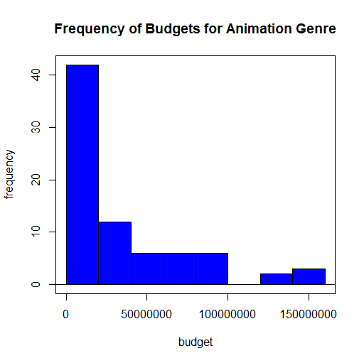
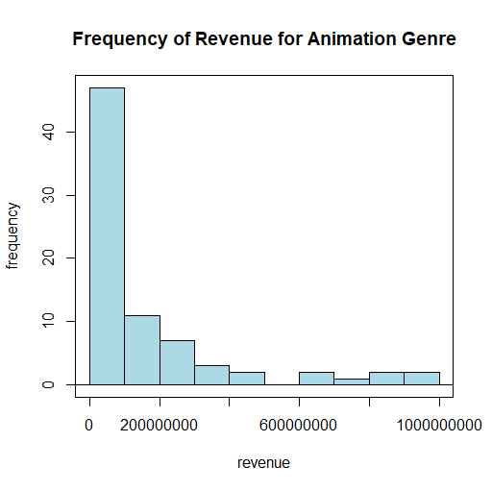
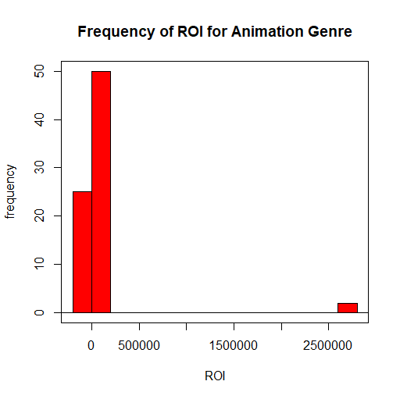
Budget, Revenue and ROI- Animation
Large differences in the data in how lower values are reported for Budget and revenue
This skews the ROI calculation
Future projections were made on Revenue
Notes:
Animation <- read.table("C:/Users/scrouch/Desktop/Syracuse University/IST 687/Project/animation_1.csv",header=TRUE, sep=",", na.strings="NA", dec=".", strip.white=TRUE)
Budget_hist<-hist(Animation$budget,main="Frequency of Budgets for Animation Genre",
scale= "frequency",
xlab= "budget",
breaks= 10,
col="blue")
Revenue_hist<-hist(Animation$revenue,main="Frequency of Revenue for Animation Genre",
scale= "frequency",
xlab= "revenue",
breaks= 10,
col="lightblue")
ROI_hist<-hist(Animation$ROI,main="Frequency of ROI for Animation Genre",
scale= "frequency",
xlab= "ROI",
breaks= 10,
col="red")

Slide 7
What factors impact Revenue?
What factors were most impactful on Revenue for Animation and Music?
Budget
Popularity- incorporates number of votes, views per day, positive reviews, release date etc
Runtime- length of the film
Vote Count- the number of people who watched the film-good or bad
What models are most predictive of Revenue?
Linear models
SVM/KSVM
Neural nets

Slide 8
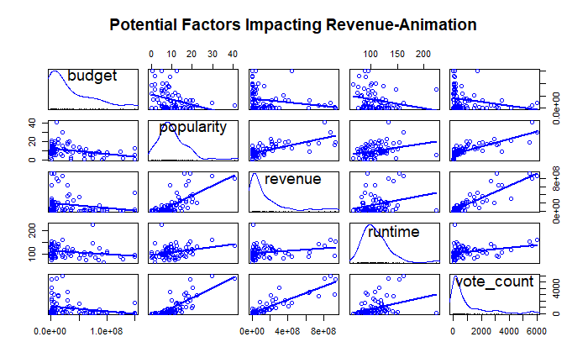
Factors impacting Revenue- animation
Looking at our top parameters:
Budget
Popularity
Runtime
Vote count
Strong linear correlation between revenue and vote counts
Less strong with popularity and runtime
Ideally we would like to predict on Budget or Runtime- things we can control!!
Notes:
Animation <- read.table("C:/Users/scrouch/Desktop/Syracuse University/IST 687/Project/animation_1.csv",header=TRUE, sep=",", na.strings="NA", dec=".", strip.white=TRUE)
#install.packages("lattice")
#install.packages("car")
library(car)
library(lattice)
sp_matrix_animation<-scatterplotMatrix(~ budget+popularity+revenue+runtime+vote_count, data=Animation, main="Potential Factors Impacting Revenue", regLine=TRUE, smooth=FALSE, diagonal=list(method="density"))

Slide 9
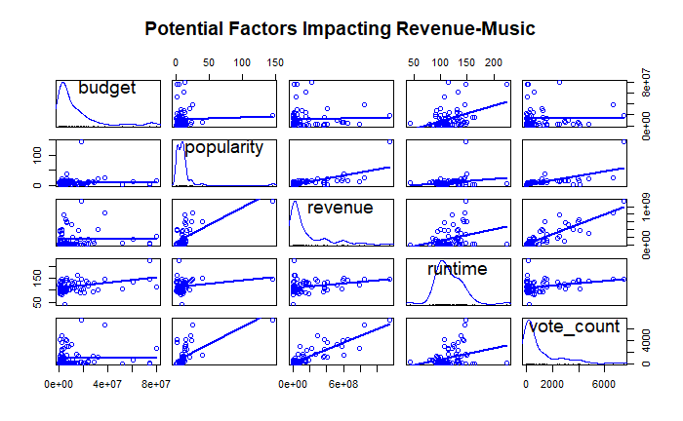
Factors impacting Revenue- music
Looking at our top parameters:
Budget
Popularity
Runtime
Vote count
Strong linear correlation between revenue and vote counts
Less strong with popularity and runtime
Ideally we would like to predict on Budget or Runtime- things we can control!!
Notes:
Music <- read.table("C:/Users/scrouch/Desktop/Syracuse University/IST 687/Project/music_1.csv",header=TRUE, sep=",", na.strings="NA", dec=".", strip.white=TRUE)
#install.packages("lattice")
#install.packages("car")
library(car)
library(lattice)
sp_matrix_animation<-scatterplotMatrix(~ budget+popularity+revenue+runtime+vote_count, data=Music, main="Potential Factors Impacting Revenue", regLine=TRUE, smooth=FALSE, diagonal=list(method="density"))

Slide 10
Predicting Revenue- Budget_linear model
As suggested by the previous scatterplots, the linear model is a poor fit. Although it is marginally significant, it has a very poor R²
lm(formula = revenue ~ budget, data = animation)
Residuals:
Min 1Q Median 3Q Max
-191229250 -132784285 -74693120 29587311 742126730
Coefficients:
Estimate Std. Error t value Pr(>|t|)
(Intercept) 191901634.4917 33806374.9684 5.676 0.000000246 ***
budget -1.1528 0.6379 -1.807 0.0748 .
---
Signif. codes: 0 '***' 0.001 '**' 0.01 '*' 0.05 '.' 0.1 ' ' 1
Residual standard error: 229100000 on 75 degrees of freedom
Multiple R-squared: 0.04172, Adjusted R-squared: 0.02895
F-statistic: 3.266 on 1 and 75 DF, p-value: 0.07476
animation

Slide 11
Predicting Revenue- Budget_linear model
As suggested by the previous scatterplots, the linear model is a poor fit with a very poor R² and p-value
lm(formula = revenue ~ budget, data = music)
Residuals:
Min 1Q Median 3Q Max
-158516998 -145440046 -115955404 27155725 1000071032
Coefficients:
Estimate Std. Error t value Pr(>|t|)
(Intercept) 149007083.6325 34277790.0601 4.347 0.0000446 ***
budget 0.2348 1.5750 0.149 0.882
---
Signif. codes: 0 '***' 0.001 '**' 0.01 '*' 0.05 '.' 0.1 ' ' 1
Residual standard error: 237700000 on 72 degrees of freedom
Multiple R-squared: 0.0003086, Adjusted R-squared: -0.01358
F-statistic: 0.02222 on 1 and 72 DF, p-value: 0.8819
music

Slide 12
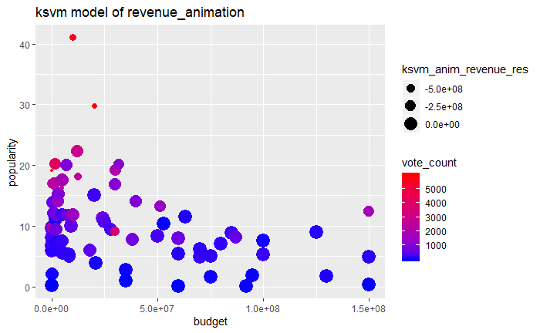
SVM models- Budget and runtime
Poor model fit with SVM models
Lower budget -> vote count
No obvious relationship to vote count
Animations are less expensive to make but very popular
Support Vector Machine object of class "ksvm"
SV type: eps-svr (regression)
parameter : epsilon = 0.1 cost C = 3
Gaussian Radial Basis kernel function.
Hyperparameter : sigma = 0.47022135669666
Number of Support Vectors : 40
Objective Function Value : -21.3946
Training error : 0.059256
Cross validation error : 2.815407e+16
Laplace distr. width : 120186909
Notes:
anim <- read.csv("C:/Users/scrouch/Desktop/Syracuse University/IST 687/Project/animation_1.csv")
dim(anim)
randIndex_anim<-sample(1:dim(anim)[1])
summary(randIndex_anim)
length(randIndex_anim)
x2_3cut<-floor(2*dim(anim)[1]/3)
x2_3cut
train_anim<-anim[randIndex_anim[1:x2_3cut],]
test_anim<-anim[randIndex_anim[(x2_3cut+1):dim(anim)[1]],]
# Build a model (using the ‘ksvm’ function, trying to predict ozone). You can use all the possible attributes, or select the attributes that you think would be the most helpful.
ksvm_anim<-ksvm(revenue ~ budget+runtime+popularity + vote_count, data=train_anim, kernel="rbfdot", kpar = "automatic", C=3, cross = 2, prob.model =TRUE)
print(ksvm_anim)
str(test_anim)
ksvm_animPred<-predict(ksvm_anim, test_anim, type = "decision")
ksvm_anim_df<-data.frame(test_anim, ksvm_animPred)
ksvm_anim_revenue_rmse<- sqrt(mean((ksvm_animPred-test_anim$revenue)^2))
anim1<-cbind(anim, ksvm_anim_revenue_rmse)
ksvm_anim_revenue_res<-(ksvm_anim_revenue_rmse-anim1$revenue)
anim2<-cbind(anim1, ksvm_anim_revenue_res)
scat_ksvm_anim<-ggplot(anim2, aes(x=budget, y=popularity, color = vote_count)) + geom_point(aes(size=ksvm_anim_revenue_res)) + ggtitle("ksvm model of revenue_animation")+scale_color_gradient(low="blue", high="red")
scat_ksvm_anim

Slide 13
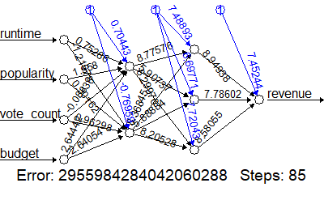
Neural nets- predicting revenue
Using more complex modeling with neural nets did not improve our predictivity of revenue
movie_net<-neuralnet(revenue ~ (runtime + popularity+vote_count +budget), PRRB_1, hidden = c(2, 3), lifesign="minimal", linear.output =FALSE, threshold =0.0001)
Notes:
# Install packages if necessary
#install.packages("neuralnet")
library(neuralnet)
PRRB_1<-read.csv(file = "C:/Users/scrouch/Desktop/Syracuse University/IST 687/Project/animation_1.csv", header=TRUE, sep=",")#importing the dataset
names(PRRB_1)
movie_net<-neuralnet(revenue ~ (runtime + popularity+vote_count +budget), PRRB_1, hidden = c(2, 3), lifesign="minimal", linear.output =FALSE, threshold =0.0001)
movie_net$result.matrix
plot(movie_net)
```
```{r}
install.packages("ggplot2")
library(ggplot2)
PRRB_1$pred_rev <- predict(lm(revenue ~ (runtime), data=PRRB_1))
p1 <- ggplot(PRRB_1, aes(x = runtime, y = revenue))
p1 + geom_point(aes(color = popularity)) +
geom_line(aes(y = pred_rev))
PRRB_1$pred_rev1 <- predict(lm(revenue ~ (popularity), data=PRRB_1))
p1 <- ggplot(PRRB_1, aes(x = popularity, y = revenue))
p1 + geom_point(aes(color = runtime)) + xlim(0, 50)+
geom_line(aes(y = pred_rev1))

Slide 14
Predicting by vote_count
Although not ideal, we are able to predict revenue on vote count
Therefore we could predict potential profits early, based on early vote counts or decide to withdraw the film
lm(formula = revenue ~ vote_count, data = animation)
Residuals:
Min 1Q Median 3Q Max
-350724426 -38589091 -13419307 34104232 429023854
Coefficients:
Estimate Std. Error t value Pr(>|t|)
(Intercept) 13123436 14183143 0.925 0.358
vote_count 154994 8788 17.636 <2e-16 ***
---
Signif. codes: 0 '***' 0.001 '**' 0.01 '*' 0.05 '.' 0.1 ' ' 1
Residual standard error: 103100000 on 75 degrees of freedom
Multiple R-squared: 0.8057, Adjusted R-squared: 0.8031
F-statistic: 311 on 1 and 75 DF, p-value: < 2.2e-16

Slide 15
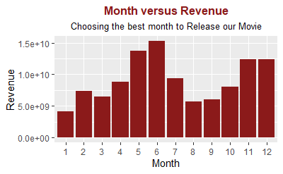
RELEASE DATE
Based on months that generate the most revenue, our movie should be released in May- June
Notes:
#convert date from 1/2/1920 to 1920-1-2
moviedata6$budget<-as.integer(moviedata6$budget)
moviedata6$release_date<-as.Date(moviedata6$release_date)
moviedata6
#break date to three column
#install.packages("lubridate")
library(lubridate)
moviedata6$month <-month(ymd(moviedata6$release_date))
moviedata6$month<-as.factor(moviedata6$month)
moviedata6
#install.packages("ggplot2")
library(ggplot2)
#install.packages("dplyr")
library(dplyr)
bar<-ggplot(data=moviedata6,aes(x = moviedata6$month, y=moviedata6$revenue))+geom_bar(stat="identity", fill="firebrick4") + xlab("Month") + ylab("Revenue")+
labs(title = "Month versus Revenue",
subtitle = "Choosing the best month to Release our Movie") + theme(plot.title = element_text(lineheight = 0.9, hjust = 0.5,color = "firebrick4", size = 12, face = "bold"), plot.subtitle = element_text(lineheight = 0.9, hjust = 0.5,color = "black", size = 10, ))
bar
#colnames(moviedata6) # list of column names in moviedata6

Slide 16
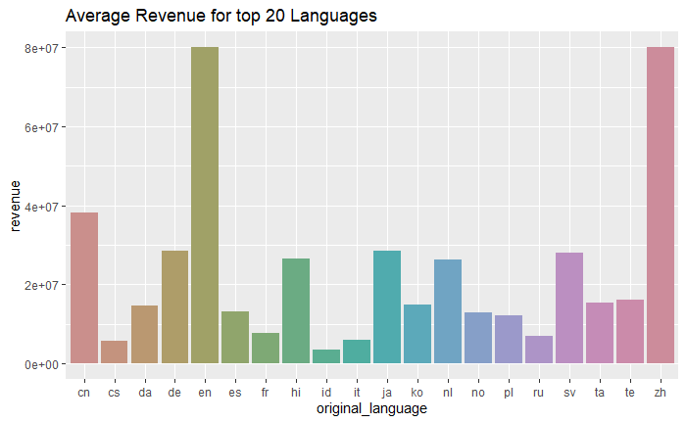
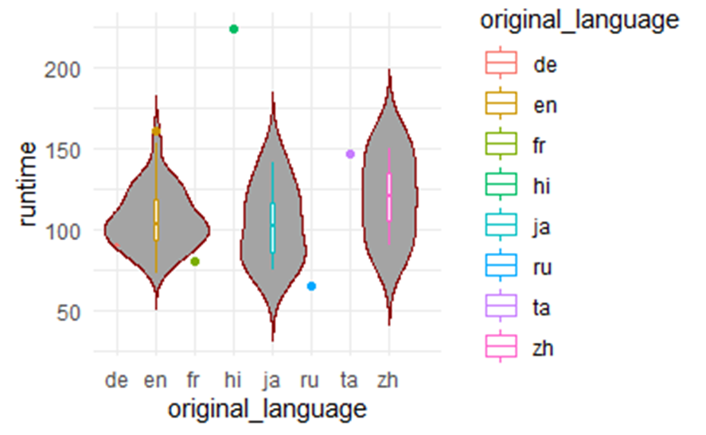
LANGUAGE/RUNTIME
We will launch our movie in English then in chinese, german and japanese with a runtime of ~100minutes and no longer than 160 minutes
Notes:
Bar graph
#install.packages("ggplot2")
#install.packages("dplyr")
library(ggplot2)
library(dplyr)
class(moviedata6$budget)
class(moviedata6$original_language)
#creating a dataframe of mean budget and language
Budget_lang_aggr<-aggregate(budget ~ original_language, moviedata6, mean)
bla.df<-data.frame(Budget_lang_aggr)
# sorting the bla dataframe first ordering budget in ascending order, taking the top 20 values grouped by language
bla1.df<-bla.df %>%
arrange(desc(budget)) %>% slice(1:20)%>%
group_by(original_language)
#creating a dataframe of mean revenue and language
revenue_lang_aggr<-aggregate(revenue ~ original_language, moviedata6, mean)
rla.df<-data.frame(revenue_lang_aggr)
# sorting the rla dataframe first ordering revenue in ascending order, taking the top 20 values grouped by language
rla1.df<-rla.df %>%
arrange(desc(revenue)) %>% slice(1:20)%>%
group_by(original_language)
# Boxplot of revenue and original language
basic_boxplot_revenue<-boxplot(revenue~original_language,data=rla1.df, main="Average revenue per language",
xlab="Language", ylab="Average Revenue")
print(basic_boxplot_revenue)
#generate a bar plot of the top 20 original languages and the mean budget
basic_barplot_budget<-ggplot(bla1.df, aes(x=original_language,y = budget)) +geom_bar(stat = "identity")
print(basic_barplot_budget)
#generate a bar plot of the top 20 original languages and the mean budget using the "hue" colour scheme
hue_barplot<-ggplot(rla1.df, aes(x=original_language, fill=original_language, y = revenue)) +geom_bar(stat = "identity")+ scale_fill_hue(c = 40) + theme(legend.position="none")+ggtitle("Average Revenue for top 20 Languages")
print(hue_barplot)
Violin graph
anim_data <- read.csv("C:/Users/scrouch/Desktop/Syracuse University/IST 687/Project/animation_1.csv")
names(anim_data)
anim_data1<-ggplot(anim_data, aes(x = original_language, y = runtime))+
geom_point() +
geom_violin(stat = "smooth", method = "loess") +
theme(legend.position="top",
axis.text=element_text(size = 6))
anim_data1<-ggplot(anim_data, aes(x = original_language, y = runtime, color =original_language))+
geom_point() +
geom_violin(trim=FALSE, fill='#A4A4A4', color="darkred")+
geom_boxplot(width=0.1) + theme_minimal()

Slide 17
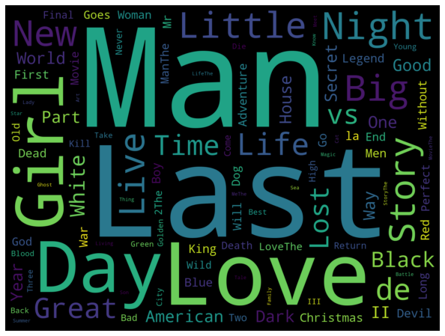
TITLE
Using the titles of the most popular movies, we established the title of our movie as:
THE MAN WHO LOVED HIS LITTLE GIRL

Slide 18
KEY TAKEAWAYS
Data preparation was key for this project since the dataset was so large
Identifying a genre helped to focus which movie area we would work in and develop models
Even with large datasets, we rarely had models that fit well- only once we limited scope we could identify models with good fit and minimal error
Unable to design practically predictive models for revenue using our data
Although the dataset was not informative from a revenue perspective, it provided a lot of details to help design the movie- release date, movie title, language etc.

Slide 19

CONCLUSION
Based on our data we will create a cartoon that tells the story the antics of a rugged Dad from Montana and his daughter who leaves the snow for sunny California
The Animation will be released in the summer to an English speaking audience with a runtime of 100-160 minutes
We will monitor early signs of the vote count to extrapolate potential sales and monitor markets for expansion.

